Slide 1
Text Mining: Bank Reviews Case Study

Slide 2
Business Problems To Be Solved:
Classification of Bank Reviews into Positive, Negative and Neutral
Key Positive and Negative Words (Most Frequent Words)
Identifying Key Themes and Intent Analysis
Classifying Star Ratings given to the Bank

Slide 3
Data Preprocessing
Converting the Reviews into lower case
Removing special characters from the Reviews
Lemmatizing the words in Reviews

Slide 4
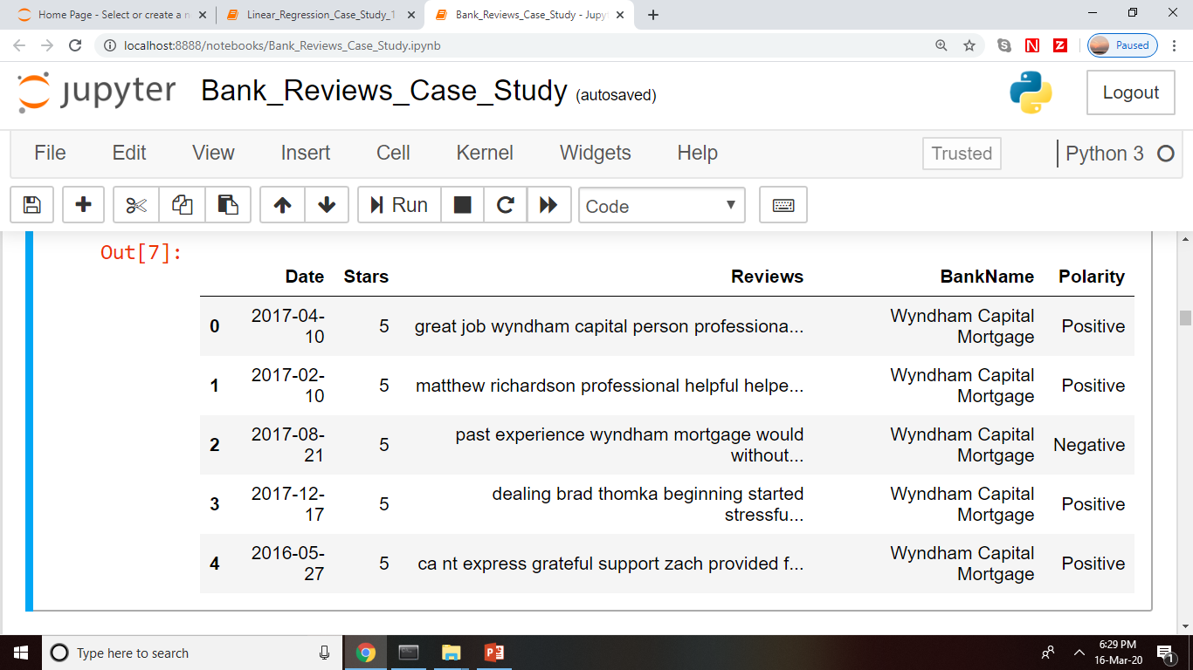
Problem 1: Classification of Bank Reviews into Positive, Negative and Neutral
Features Used : Reviews given by Customers
Technique Used to solve the Problem: TextBlob() function in textblob package

Slide 5
Problem 2: Key Positive and Negative Words (Most Frequent Words)
Features Used : Noun list from positive and negative reviews body as calculated in the previous problem
Technique Used to solve the Problem: POS Tagging to get Nouns followed by FreqDist() function from ‘nltk’ package
20 most frequent positive and negative words are calculated and represented as ‘Count vs Word’ Graph

Slide 6
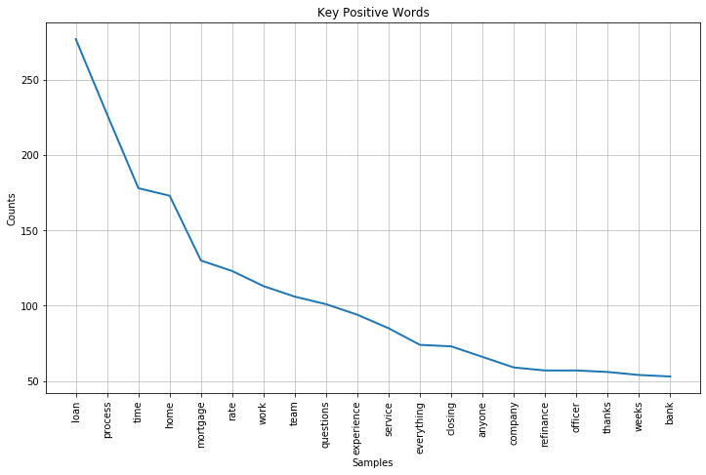
Problem 2: Key Positive and Negative Words (Most Frequent Words)

Slide 7
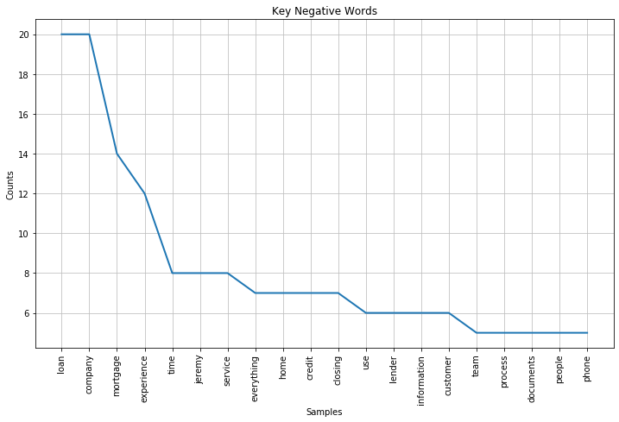
Problem 2: Key Positive and Negative Words (Most Frequent Words)

Slide 8
Problem 3: Identifying Key Themes of Problems and Intent Analysis
Features Used : Bigrams and Trigrams of the Reviews which have Low Star Rating i.e. 1
Technique Used to solve the Problem: K-Means Clustering followed by Topic Modelling on each unique cluster

Slide 9
Problem 3: Identifying Key Themes of Problems and Intent Analysis
Modelling Steps:
Making ‘Term Document Matrix (TDM)’ from Bigrams and Trigrams of the Reviews with Star Rating of 1 using ‘TfidfVectorizer()’
Standardizing the TDM using ‘StandardScalar()’
Applying ‘Principal Component Analysis (PCA)’ for Variable Reduction
K-Means Technique for Clustering is used with K (number of clusters) ranging from 3 to 10

Slide 10
Problem 3: Identifying Key Themes of Problems and Intent Analysis
Deciding the Number of Clusters (K) = 7 here:
 | QUANTITATIVE ANALYSIS | SILHOUETTE COEFFICIENT | CLUSTER ERRORS
K=3 | 98%,1%,1% | -0.392 | 566046.80
K=4 | 97%,1%,1%,1% | -0.389 | 543017.11
K=5 | 94%,3%,1%,1% | -0.347 | 517254.56
K=6 | 92%,3%,2%,1%,1%,1% | -0.317 | 485614.82
K=7 | 89%,3%,3%,2%,1%,1%,1% | -0.274 | 454752.14
K=8 | 88%,3%,3%,2%,1%,1%,1%,1% | -0.285 | 445485.76
K=9 | 87%,3%,3%,2%,1%,1%,1%,1%,1% | -0.282 | 419375.24
K=10 | 83%,4%,3%,3%,2%,1%,1%,1%,1%,1% | -0.229 | 388655.14

Slide 11
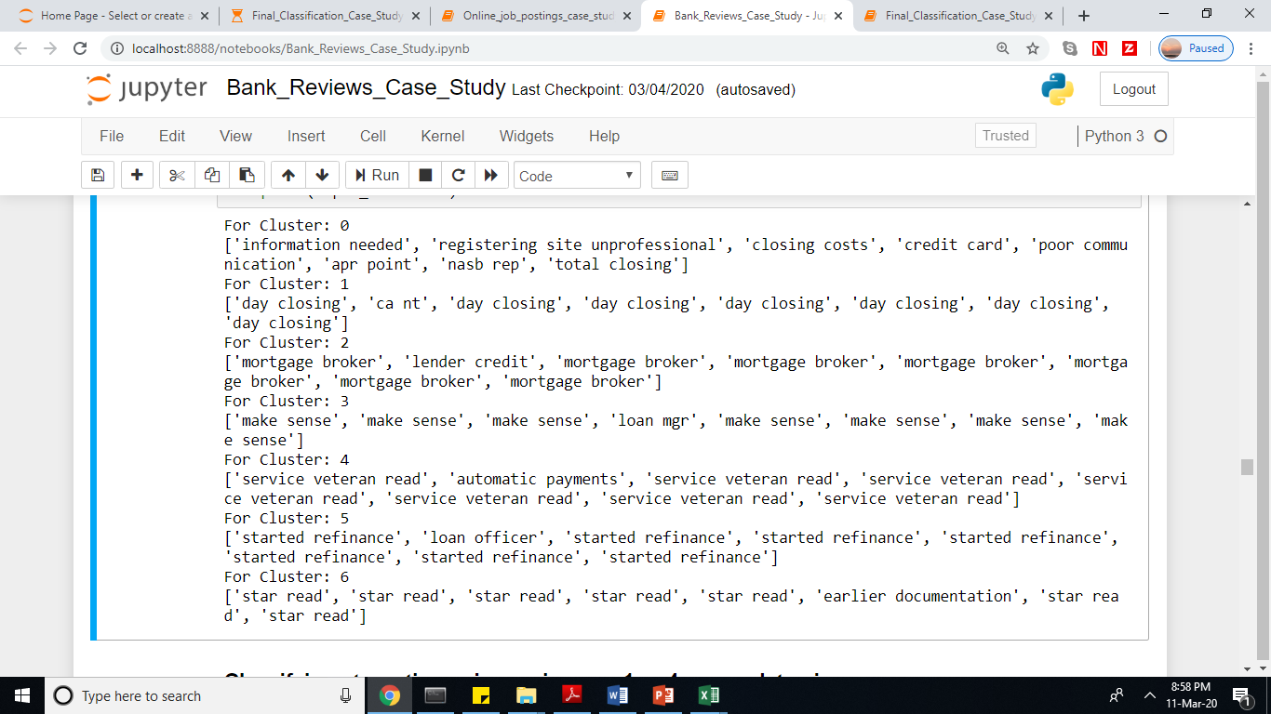
Problem 3: Identifying Key Themes of Problems and Intent Analysis
For each of the seven clusters, topic modelling is applied to extract the key themes

Slide 12
Problem 4: Predicting Star Ratings Given to the Bank
Features Used : Unigrams of the Reviews after removing Stop words
Technique Used to solve the Problem: Random Forest Regressor

Slide 13
Problem 4: Predicting Star Ratings Given to the Bank
Modelling Steps:
Making ‘Term Document Matrix (TDM)’ from Unigrams of the Reviews
Outlier Analysis – In the TDM, the outliers are capped at bottom 1 percentile and top 99 percentile respectively for each Feature obtained above
We cannot use Linear Regression to predict here as the Dependent Variable does not follow Normal Distribution and having only two values in the data provided, it cannot be Transformed to Normal Distribution as well

Slide 14
Problem 4: Predicting Star Ratings Given to the Bank
Modelling Steps:
Random Forest Regressor is fitted on Train Data and used to predict the Star Ratings on Test Data
MSE, MAPE, Correlation with Dependent Variable are the metrics used to evaluate the performance of the model

Slide 15
Problem 4: Predicting Star Ratings Given to the Bank
Model Evaluation Metrics :
 | TRAIN | TEST
RMSE | 0.420 | 0.940
MAPE | 0.134 | 0.298
CORRELATION WITH DEPENDENT VARIABLE | 0.972 | 0.809

